Slide 1
The Anatomy of Nativism

Slide 2
What is Nativism?
Nativism is the political position of preserving status for certain established inhabitants of a nation as compared to claims of newcomers or immigrants.

Slide 3
Examples of Nativism in U.S. History
Discrimination against Irish Immigrants
Red summer riots of 1919
Japanese internment camps during WWII
Native American boarding schools
Zoot suit riots
Anti-Muslim attitudes post 9/11

Slide 4
What causes these attitudes?
Economic fears
Political concerns
Racism
Xenophobia
These factors are considered to be the “vital organs” or the essential elements of nativism.

Slide 5
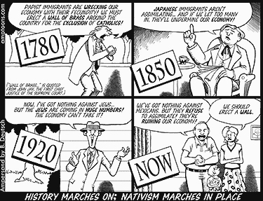
Economic Fears
Notes:
Image Source: http://neveryetmelted.com/wp-content/uploads/2014/06/immigration-history1.jpg

Slide 6
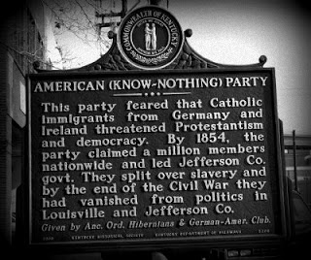
Political Concerns

Slide 7
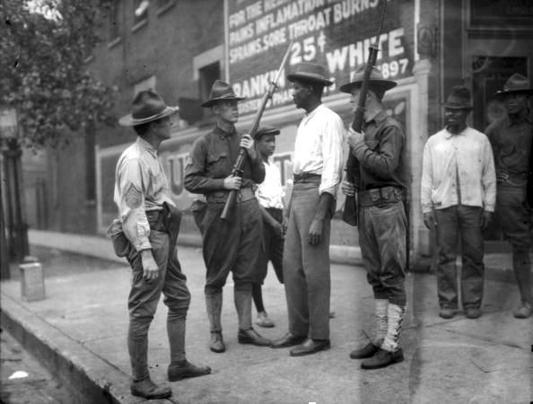
Racism
Notes:
Image Source: http://blackthen.com/the-red-summer-of-1919-race-riots-in-over-3-dozen-u-s-states/

Slide 8
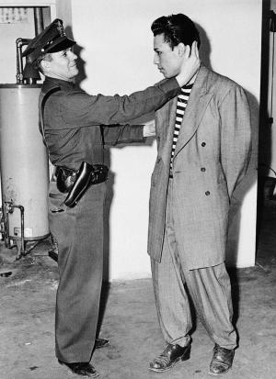
Xenophobia
Notes:
Xenophobia and racism often overlap, but are distinct phenomena. Whereas racism usually entails distinction based on physical characteristic differences, such as skin color, hair type, facial features, etc. Xenophobia implies behavior based on the idea that the other is foreign to or originates from outside the community or nation. (UNESCO)

Slide 9
How are these ideas perpetuated in our society?
Fear
Propaganda
Us-vs-them mentality
Exploitation
These are considered to be the “reproductive organs” or the elements that allow nativism to continue in our society.

Slide 10

Fear
Notes:
Image source: http://www.elephantjournal.com/2010/08/welcome-to-the-united-snakes-john-spina/

Slide 11
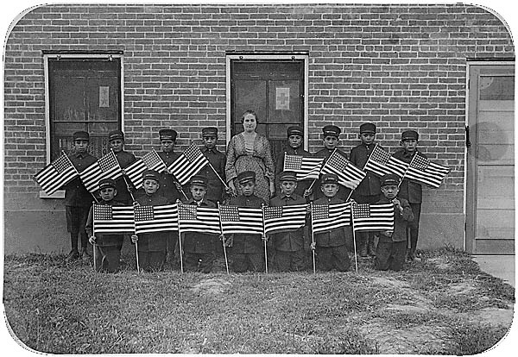
Propaganda

Slide 12
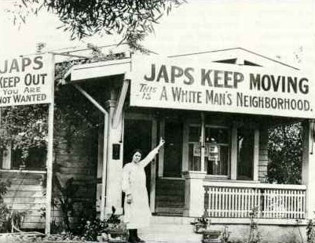
Us-vs-Them

Slide 13
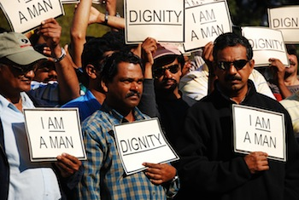
Exploitation
Notes:
Image Source: http://www.guestworkeralliance.org/tag/j-1-visa/

